Slide 1
MARKETING COMMUNICATION
2019

Slide 3
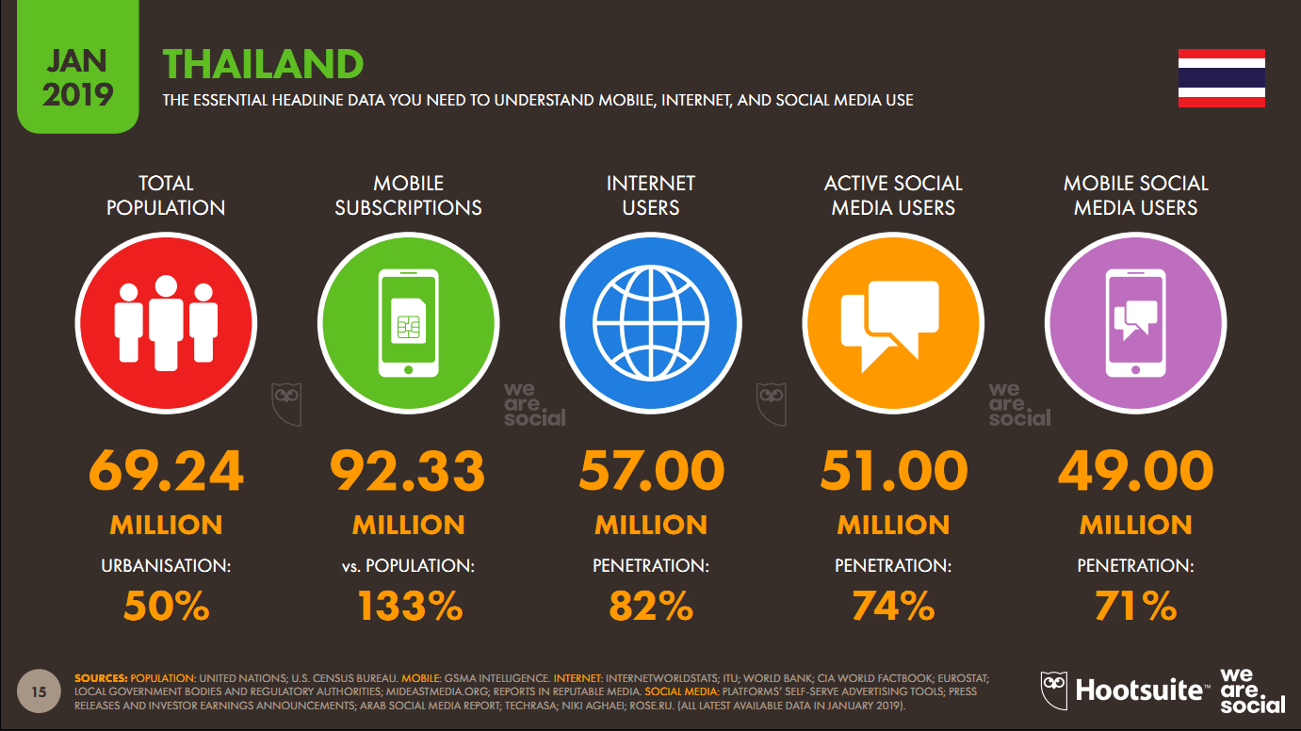

Slide 5
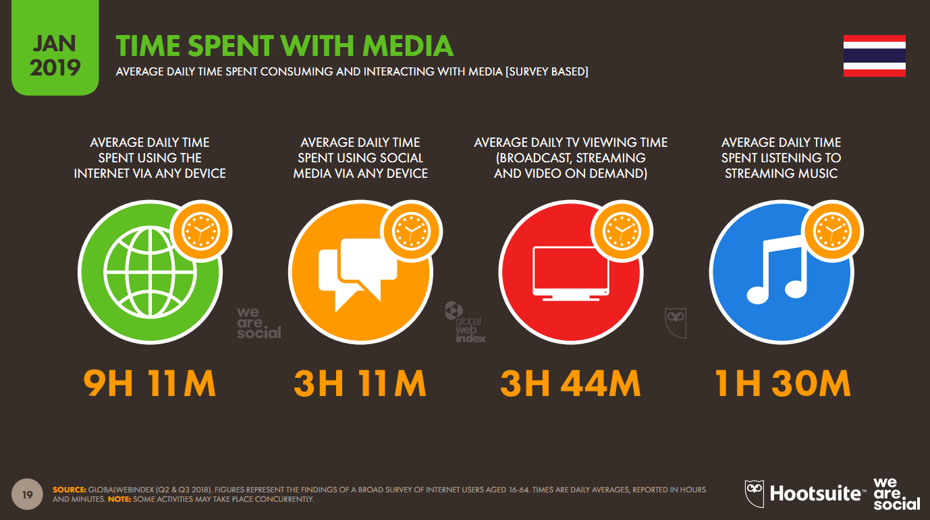

Slide 6
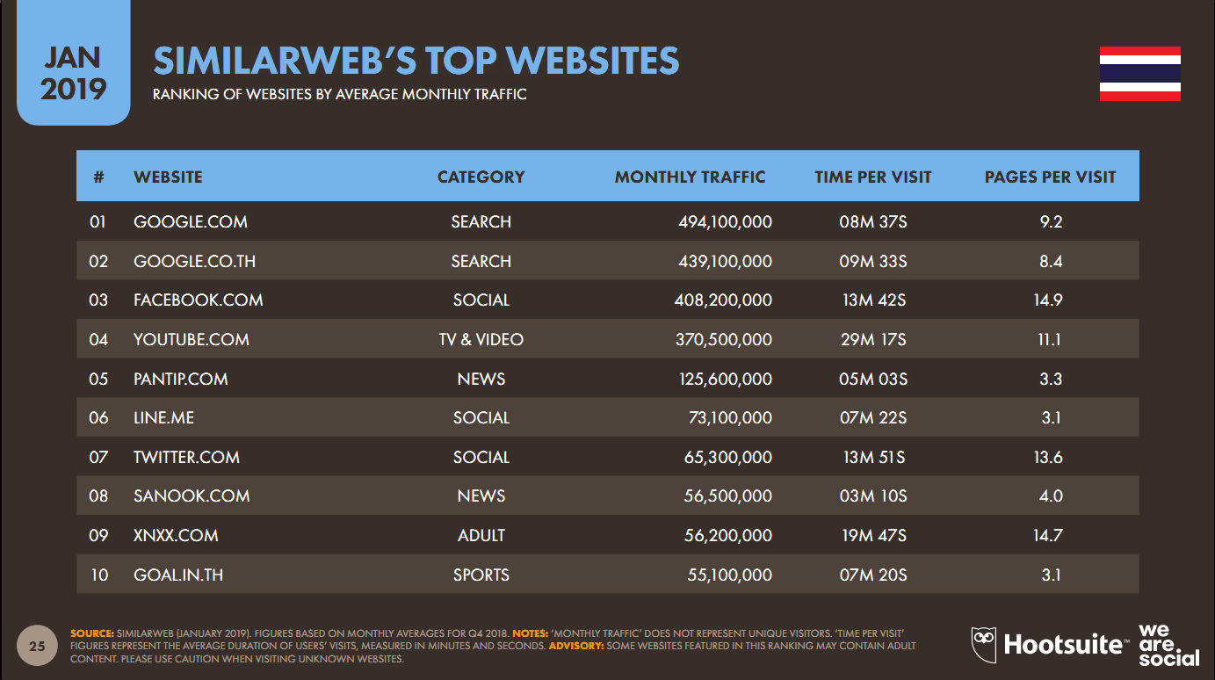

Slide 7
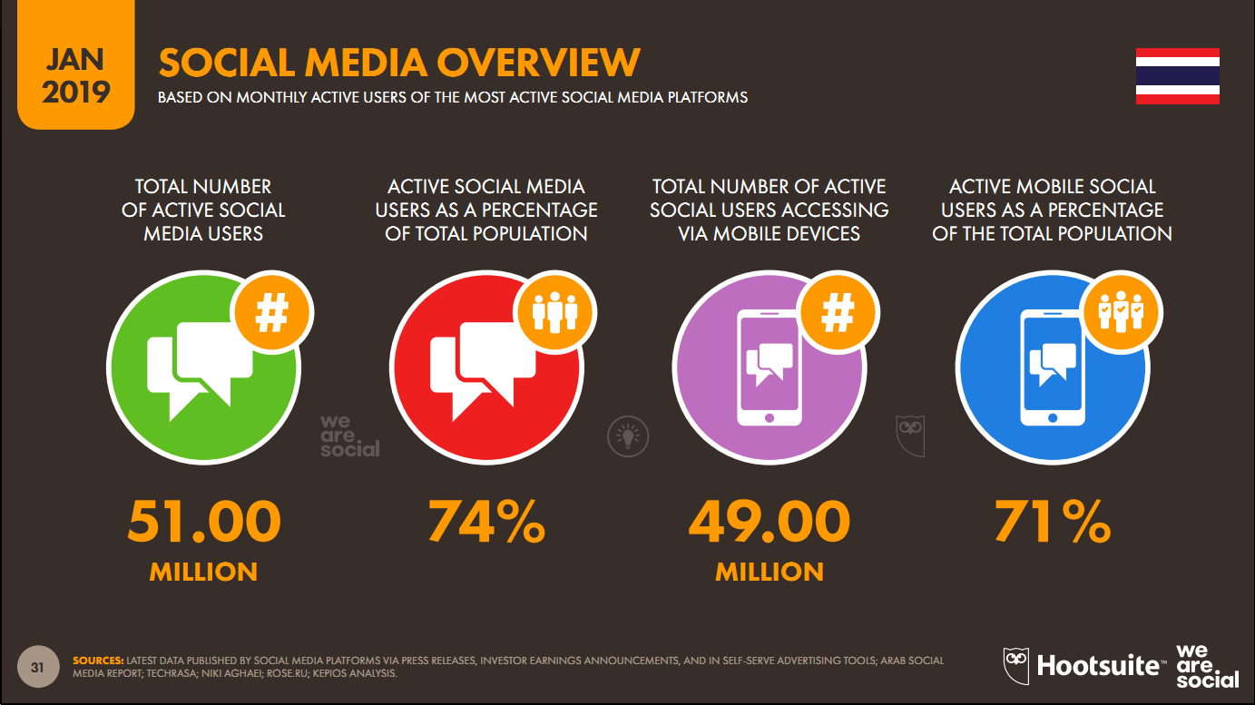

Slide 8
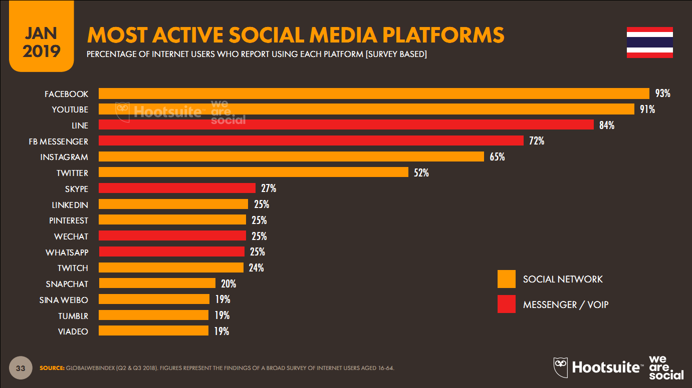

Slide 10
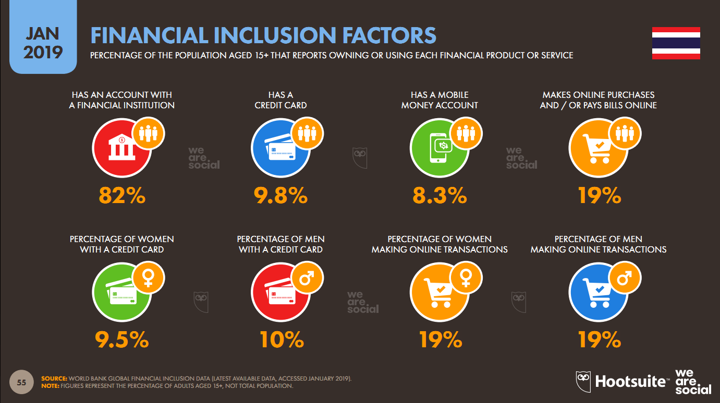

Slide 13
MARKETING MISSION
INFORM CUSTOMER
ADD CUSTOMER
ENGAGING CUSTOMER
SERVE CUSTOMER
CUSTOMER RETENTION
RELATIONSHIP CUSTOMER
SELL CUSTOMER

Slide 14
STRATEGY TO CONNECTED EXPERIENCE
DIGITAL COMMERCE
CONTENT & VIDEO MARKETING
SEO : ORGANIC SEARCH
PAID MEDIA : GOOGLE ADS /
PROGRAMMATIC DISPLAY
SOCIAL MEDIA & CHAT MARKETING
LEAD GENERATION / EMAIL MARKETING
MULTI-CHANNEL ANALYTICS
INTEGRATED PLANNING : ALWAYS-ON+CAMPAIGNS
DIGITAL PR

Slide 15
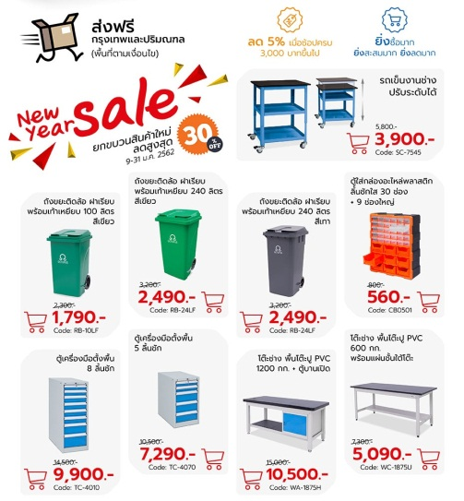
PROMOTION 2019

Slide 16
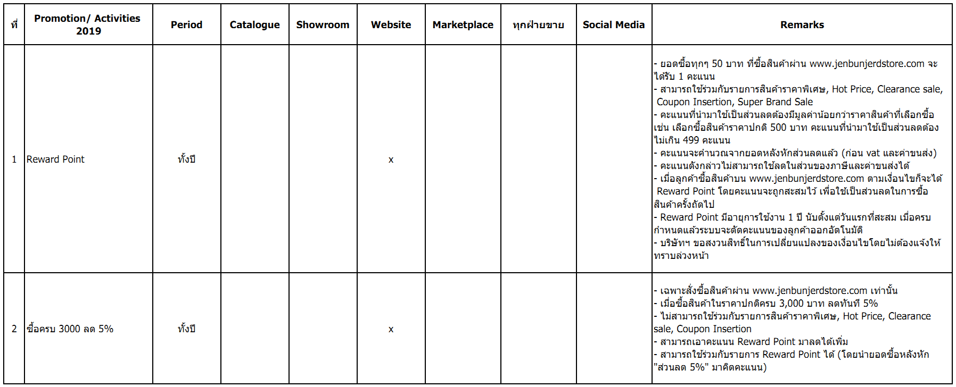
PROMOTION 2019

Slide 17
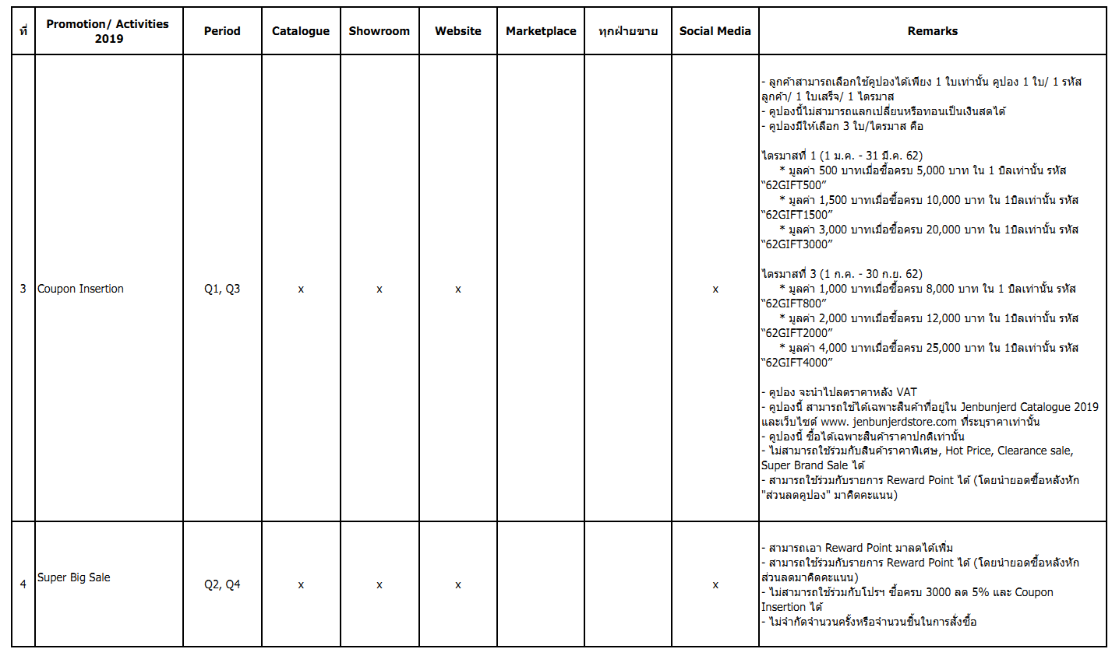
PROMOTION 2019

Slide 18
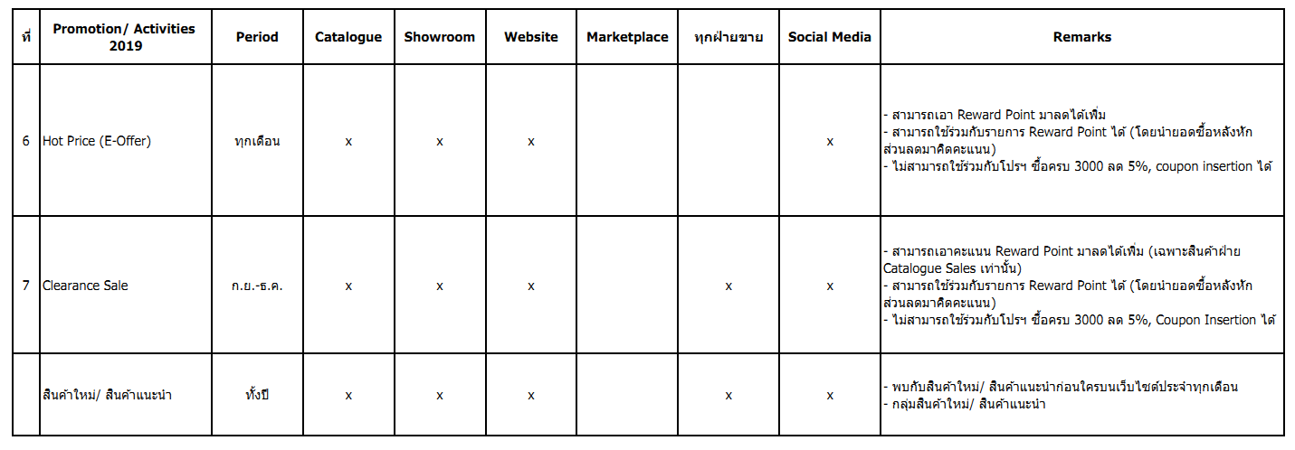
PROMOTION 2019

Slide 19
Thank you

